Slide 1
Open Source Software Engineering
Module-2

Slide 2
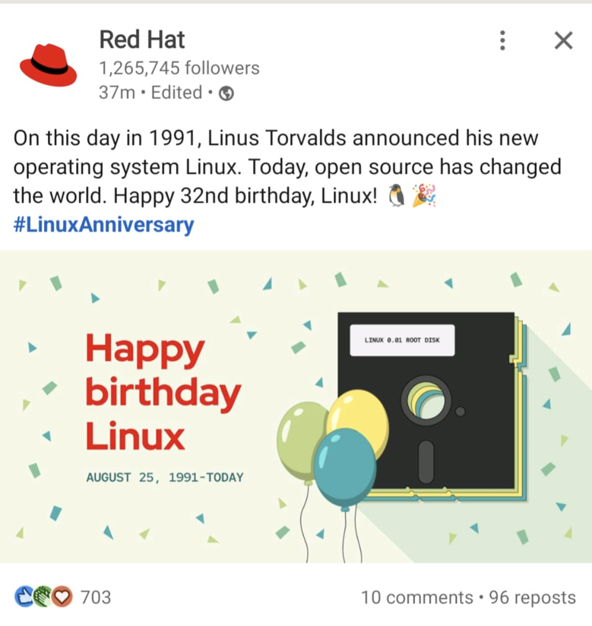
Linux Birthday : 25th Aug

Slide 3
Contents
Understanding Free Software
Understanding Open Source Software
Understanding Freeware
Understanding Public- domain Software

Slide 4
Free Software
Definition: Free software is the software that can be used, modified, studied, copied, changed, and redistributed (with or without modifications), with no restrictions.
Free software – refers to free use of software and not price.
Charge: Free software is available free of charge, in most cases. But, in principle, free software need not necessarily be free of cost.
Copyright: Yes

Slide 5
Why Free?
Social Movement[philosophy: free for all to use]
Started by Richard Stallman
Started with a GNU project
Started free software foundation
Establishment of free software foundation in 1983

Slide 6
4-Essential Freedoms
Run and use the program for any purpose
Study the program and change/modify as per your needs/requirements
Access to source code
Redistribute to help others.
Redistribute modified versions also.
Access to source code
Note: Four Essential Freedoms (https://www.gnu.org/philosophy/free-sw.html)

Slide 7
Few examples of Free Software
Linux kernel
GNU Compiler Collection
MySQL
Apache Web Server
Libre Office ….

Slide 8
Licenses associated with free software
GNU General Public License [versions exist]
Apache License
Berkely database License …
Full list: https://www.gnu.org/licenses/license-list.html
Note: Above listed ones are qualified licenses for free software.
You can design your own license also*.
*: must grant the four freedoms and should be compatible with GNU license.

Slide 9
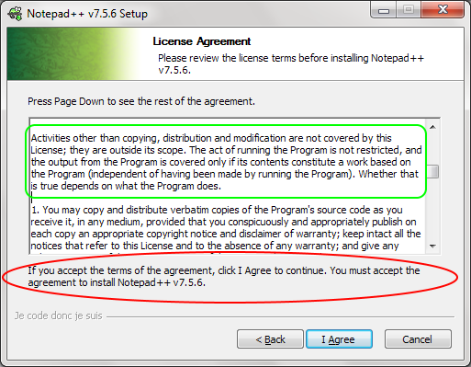
We blindly click “I Agree”

Slide 10
Then Why different licenses?
You can add restrictions related to commercialization/paid etc .
Credits related info…

Slide 11
Important Points
Free software does not necessarily mean non commercial.
Possible to copy the free software then sell[with or without modification]
Legal restrictions:*
Owner does not have any power to revoke the license or do any changes in terms and conditions.
*: legal restrictions will not hold if the developer uses a Free software and later does not release it under free software license.

Slide 12
Open Source Software
Source code is released under a license.
Owner gives the permission to use[modify, distribute] the source code.
Philosophy: promote further development and collaboration
Anybody and everyone can participate contribute and use.
Governed by rules: https://opensource.org/osd
Cost: Most cases its free of any charges, but can be associated with some cost.
Examples: Eclipse[raw/compiled/stable form],

Slide 13
Principles behind OSS
Decentralized software development [not controlled by any company]
Open collaboration
Peer production
Done through
Loosely coordinated participants
Self driven

Slide 14
Rules of Open Source Software
Free Distribution : No restriction on selling, sharing either fully or partially.
Source Code: access is mandatory. Made available publicly.
Led to the development of open source code sharing and managing platforms like sourceforge and Git.
Derived Works: Allow modifications to the OSS and be distributed further under the original license.
Preserving the integrity of the OSS: Modified source code may be restricted from distribution provided the license allows distribution of patch files.
No discrimination based on persons or groups.
No discrimination based on fields of use/application:[ex: business, research].

Slide 15
Distribution of license: No additional license is required for further redistribution.
License should not be product specific: rights and restrictions are general irrespective of the distribution type.
License must not restrict other software: when combined with other softwares, restrictions are not placed on the other software license.
License must be technology neutral: cannot restrict based on interface being used or the underlying technology/platform.

Slide 16
Examples
MIT License
GNU general public license
Apache license etc

Slide 17
Freeware
Free of cost but restriction with respect to use.
Basically done for marketing and gain popularity or gauge the market.
Owner defines the rules and restrictions.
Source code is usually not made available.
No predefined license terms
Most of the cases modification and reselling is not allowed.
Examples: Adobe Acrobat, skype etc.

Slide 18
Public Domain Software
Placed in public domain
Can be used, distributed and modified.
No cost associated.
No copyright, patent, trademark laws
Comes under creative common licenses : having waivers.
Example: SQLite

